Slide 1

Heart Disease Prediction using Machine Learning Techniques
CMR Technical Campus
(UGC Autonomous)
Department of Electronics & Communication Engineering
Batch No: 6
Major Project carried out by:
A. Lahari : 197R1A04C1
A. Venkata Lokesh : 197R1A04C3
P. Dharani : 197R1A04H1
B. Shashank : 197R1A04H6
T. Shravani : 197R1A04H7
Under the guidance of:
A. VAMSHIDHAR REDDY

Slide 2
CONTENTS
Abstract
Introduction
Literature survey
Block diagram
Software Requirements
Flow chart
Algorithm
Working of the Project
Result
Conclusion
References

Slide 3
ABSTRACT :
As per the recent study by WHO, heart related diseases are increasing. 17.9 million people die every-year due to this. With growing population, it gets further difficult to diagnose and start treatment at early stage. But due to the recent advancement in technology, Machine Learning techniques have accelerated the health sector by multiple researches. Thus, the objective of this paper is to build a ML model for heart disease prediction based on the related parameters. We have used a benchmark dataset of UCI Heart disease prediction for this research work, which consist of 14 different parameters related to Heart Disease. Machine Learning algorithms such as Random Forest, Support Vector Machine (SVM), K Neighbor and Decision tree have been used for the development of model. In our research we have also tried to find the correlations between the different attributes available in the dataset with the help of standard Machine Learning methods and then using them efficiently in the prediction of chances of Heart disease. Result shows that compared to other ML techniques, K Neighbor gives more accuracy in less time for the prediction. This model can be helpful to the medical practitioners at their clinic as decision support system.

Slide 4
INTRODUCTION:
Healthcare is one of the primary focus for humanity. According to WHO guidelines, good health is the fundamental right for individuals. It is considered that appropriate health care services should be available for regular checkup of one's health. Almost 31% of all deaths are due to heart related disease in all over the world. Early detection [1] and treatment of several heart diseases is very complex, especially in developing countries, because of the lack of diagnostic centers and qualified doctors and other resources that affect the accurate prognosis of heart disease. With this concern, in recent times computer technology and machine learning techniques are being used to make medical aid software as a support system for early diagnosis of heart disease. Identification of any heart related illness at primary stage can reduce the death risk. Various ML techniques are used in medical data to understand the pattern of data and making prediction from them. Healthcare data are generally massive in volumes and complex in structure. ML algorithms are capable to handle the big data and mine them to find the meaningful information. Machine Learning algorithms learn from past data and do prediction on real time data. This sort of ML framework for coronary illness expectation can encourage cardiologists in taking quicker actions so more patients can get medicines within a shorter timeframe, thus saving large number of lives.

Slide 5
LITERATURE SURVEY:
With growing development in the field of medical science alongside machine learning various experiments and researches has been carried out in these recent years releasing the relevant significant papers.
[1] Purushottam ,et ,al proposed a paper “Efficient Heart Disease Prediction System” using hill climbing and decision tree algorithms .They used Cleveland dataset and preprocessing of data is performed before using classification algorithms. The Knowledge Extraction is done based on Evolutionary Learning (KEEL), an opensource data mining tool that fills the missing values in the data set. A decision tree follows top-down order. For each actual node selected by hill-climbing algorithm a node is selected by a test at each level. The parameters and their values used are confidence. Its minimum confidence value is 0.25. The accuracy of the system is about 86.7%.
[2] Santhana Krishnan. J ,et ,al proposed a paper “Prediction of Heart Disease Using Machine Learning Algorithms” using decision tree and Random Forest algorithm for prediction of heart disease. In decision tree algorithm the tree is built using certain conditions which gives True or False decisions. The algorithms like SVM, KNN are results based on vertical or horizontal split conditions depends on dependent variables. But decision tree for a tree like structure having root node, leaves and branches base on the decision made in each of tree Decision tree also help in the understating the importance of the attributes in the dataset. They have also used Cleveland data set. Dataset splits in 70% training and 30% testing by using some methods. This algorithm gives 84% accuracy.

Slide 6
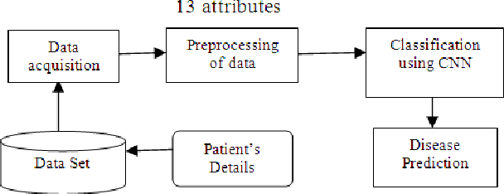
BLOCK DIAGRAM:
14 ATTRIBUTES

Slide 7
Software Requirements
we imported several libraries for the project:
NumPy: To work with arrays
pandas: To work with CSV files and data frames
matplotlib: To create charts using pyplot.
warnings: To ignore all warnings which might be showing up in the notebook
due to past/future depreciation of a feature
5. Train test split: To split the dataset into training and testing data
6.Standard Scaler: To scale all the features, so that the Machine Learning model better adapts to the dataset
7.Operating System : Windows
8.Technology : Python3.7
9.IDE : Jupiter notebook

Slide 8
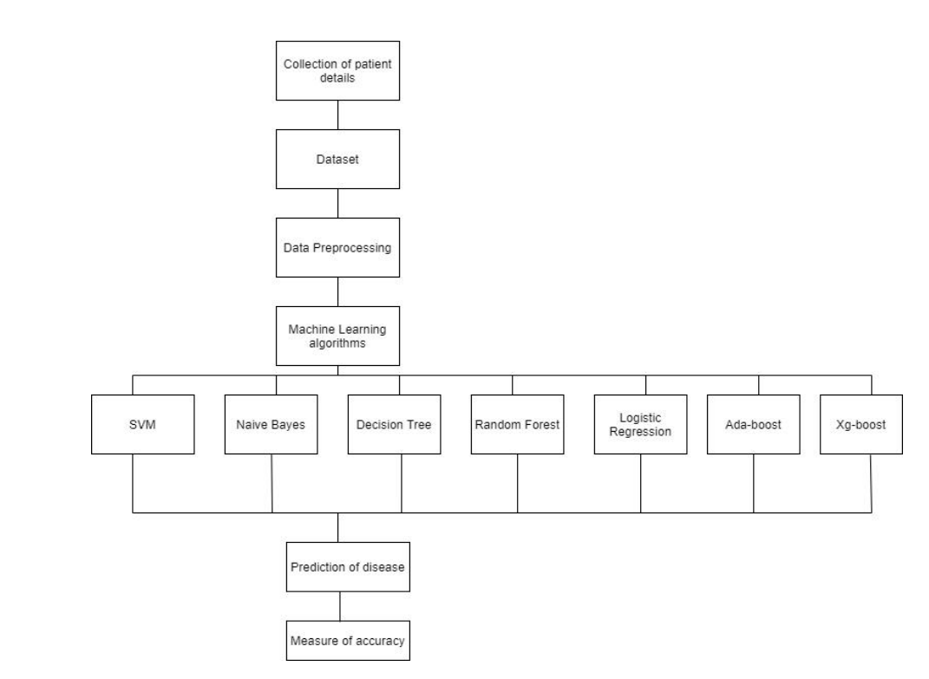
FLOW CHART:
K neighbor

Slide 9
Working of The Project:
Attributes:
1.sex: male(0) or female(1);(Nominal)
2.age: age of the patient;(Continuous - Although the recorded ages have been truncated to whole
numbers, the concept of age is continuous)
3.cp:Clinical prediction models (CPMs) estimate the probability of clinical outcomes and hold the
potential to improve decision making and individualize care. For patients with cardiovascular disease
4. trestbps: resting blood pressure (in mm Hg on admission to the hospital) anything above 130-140 is typically cause for concern
5. Chol {serum cholesterol in mg/dl} : above 200 is cause for concern.
6. fbs : The person's fasting blood sugar (> 120 mg/dl, 1 = true; 0 = false)
7. restecg {resting electrocardiographic results} : People with value 1 (signals non-normal heart beat,
can range from mild symptoms to severe problems) are more likely to have heart disease. Exang
{exercise induced angina} : People with value 0 (No ==> exercise induced angina) have heart disease
more than people with value 1 (Yes ==> exercise induced angina)

Slide 10
8. thalach {maximum heart rate achieved} : People how achieved a maximum more than 140 are more likely to have heart disease.
9. exang {exercise-induced angina}: people with a value of 0 (No ==> angina induced by exercise) have more heart disease than people with a value of 1(Yes ==> angina induced by exercise)
10. Old peak: type of chest pain and maximum heart rate achieved are also important for predicting heart disease
11. slope: The slope of the peak exercise ST segment is the most important subject to predict heart disease
12. ca {number of major vessels (0-3) stained by fluoroscopy}: the more blood movement the better, so people with ca equal to 0 are more likely to have heart disease
13. thal {thallium stress result}: People with a thal value of 2 (defect corrected: once was a defect but ok now) are more likely to have heart disease.
14. target: The goal of our heart disease prediction project is to determine if a patient should be diagnosed with heart disease The score for
Random Forest Classifier based on percentage.

Slide 11
Import libraries
Import dataset
Understanding the data
Data Processing
Using Machine Learning Algorithms:
1.K Neighbors Classifier
2.Support Vector Classifier
3.Decision Tree Classifier
4.Random Forest Classifier

Slide 12
RESULT:
At the end of our experiment, result shows that K Neighbor and Random Forest performed very well in comparison to SVM and Decision tree. Model developed with K Neighbor gives 87% accuracy which is 4% greater than the SVM and approximately 8% greater than Decision tree. In the same way, model build with Random Forest gives best prediction result with 84% accuracy, which is itself less accurate than K Neighbor for heart disease prediction. Unfortunately, we did not find decision tree suitable for our data.

Slide 13
CONCLUSION:
In this project, We used Machine Learning to predict whether a person is
suffering from a heart disease. After importing the data, we analyzed it
using plots. Then, we generated dummy variables for categorical features and
scaled other features.
We then applied four Machine Learning algorithms, `K Neighbors Classifier`,
`Support Vector Classifier`, `Decision Tree Classifier` and `Random Forest
Classifier`. We varied parameters across each model to improve their scores.
In the end, `K Neighbors Classifier` achieved the highest score of “87%” with 8 nearest
neighbors.

Slide 14
REFERENCES:
https://www.who.int/hrh/links/en/
https://en.wikipedia.org/wiki/Machine_learning
S. Pouriyeh, S. Vahid, G. Sannino, G. De Pietro, H. Arabnia and J. Gutierrez, "A comprehensive investigation and comparison of Machine Learning Techniques in the domain of heart disease," 2017 IEEE Symposium on Computers and Communications (ISCC), Heraklion, 2017, pp. 204-207, doi: 10.1109/ISCC.2017.8024530.
S. Dhar, K. Roy, T. Dey, P. Datta and A. Biswas, "A Hybrid Machine Learning Approach for Prediction of Heart Diseases," 2018 4th International Conference on Computing Communication and Automation (ICCCA), Greater Noida, India, 2018, pp. 1-6, doi: 10.1109/CCAA.2018.8777531.
C. Raju, E. Philipsy, S. Chacko, L. Padma Suresh and S. Deepa Rajan, "A Survey on Predicting Heart Disease using Data Mining Techniques," 2018 Conference on Emerging Devices and Smart Systems (ICEDSS), Tiruchengode, 2018, pp. 253-255, doi: 10.1109/ICEDSS.2018.8544333.
R. Detrano, A. Janosi, W. Steinbrunn, M. Pfisterer, J.-J. Schmid,S. Sandhu, K. H. Guppy, S. Lee, and V. Froelicher, “International application of a new probability algorithm for the diagnosis of coronary artery disease,” The American journal of cardiology, vol. 64, no. 5, pp. 304–310, 1989.
https://towardsdatascience.com/predicting-presence-of-heart-diseases-using-machine-learning-36f00f3edb2c

